Slide 1
Final Project
Shangqian Gao

Slide 2
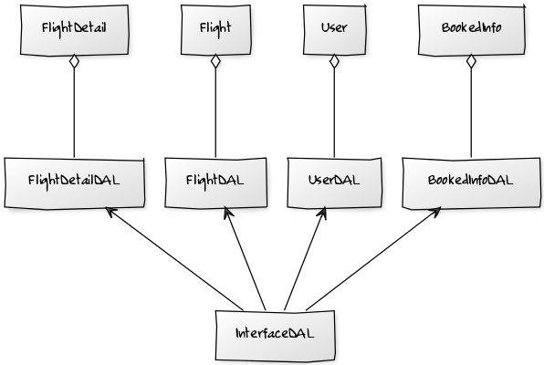
UML Diagram

Slide 3
Completed Functions
User perspective:
View all the flights and flight details
Book or unbook a flight
View booked information
Administrator perspective:
Add a new flight
Delete a flight

Slide 4
Demo
Demo Time

Slide 5
What’s left
Update flight function for administrator
Further refinement

